Slide 1
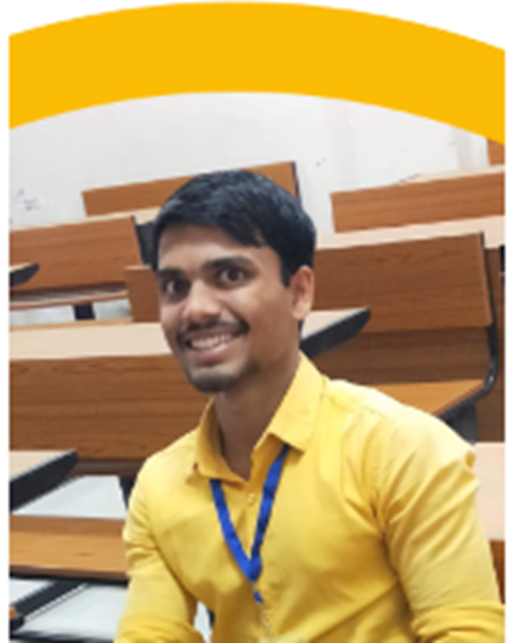


Introduction
My name is Nitin Kumar Gaur I’m from Jaunpur Uttar Pradesh.
I have done my graduation in Information Technology stream in 2021.
Now I am a Associate Software Engineer Trainee in Torry Harris Integration Solution.
I always believe in learning and apply them.
Being a Information Technology background,
I have knowledge about Web developer (UI) and
Competitive Programming in C/C++, Java.
Gold level in C, C++, Python and Mysql on Hacker Rank
(https://www.hackerrank.com/NEONITIN)
I know about Machine learning ,I also done some hands- on project on Machine Learning.
Blockchain and AI is always tech talk for me.
My hobbies are fitness and cooking

Slide 2
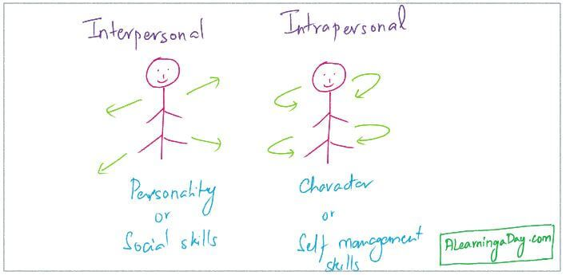
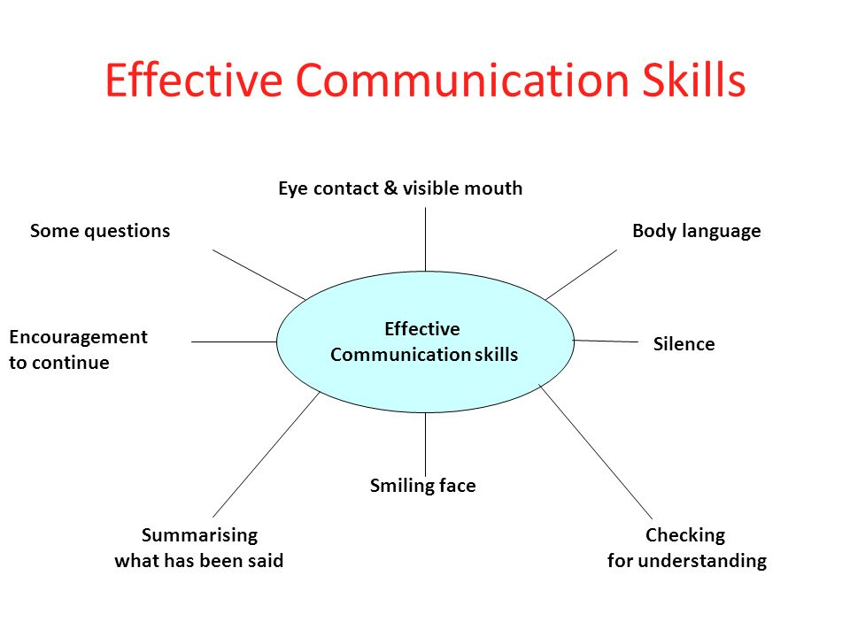
Communication skill
We can say communication work like OS which connect two more than two different system(people) to exchange the his information with others.
Communication is the activity or process of expressing ideas and feelings or of giving people information and instructions
It’s the way to explaining our thought and idea to others.
The level of communication ' Human communication takes place at a various levels
Extra personal ,Intrapersonal, Interpersonal, Organizational Mass Communication.
On the basis of the communication channels, types of communications are:
1.Verbal 2. Non-Verbal 3. Visual
>What is effective communication?
Effective communication is about more than just exchanging information. It’s about
understanding the emotion and intentions behind the information.
As well as being able to clearly convey a message, you need to also listen in
a way that gains the full meaning of what’s being said and makes the other
person feel heard and understood.
>Active Listening?
The way to improve your listening skills is to practice "active listening." This is where
you make a conscious effort to hear not only the words that another person is saying
but, more importantly, the complete message being communicated.

